Slide 2
Chapter one Introduction
1.1 Introduction:
College website is a website built, designed, and maintained by a College . In many legislation, it is a statutory requirement for college to publish certain information on-line, on their website, or elsewhere. College website software is a specialized form of Content Management System (CMS) hosted on a computer connected to the internet ,CMS may have additional modules that allow it to do additional tasks- like mass emailing’s, online registration for events or even online sales. The content of the website must comply with data protection legislation.
Educational technology or E-learning (commonly abbreviated as EduTech, or EdTech) is the combined use of computer hardware, software, and educational theory and practice to facilitate learning..

Slide 3
educational technology is based on theoretical knowledge from various disciplines such as communication, education, psychology, sociology, artificial intelligence, and computer science.
1.2 Problem Identification:
The Cambridge international college website have some problems we Explore and want to change and make it better the problems is :
Non whole Computer screen, No mobile & Tablet features, Duplicated non workable links, Difficult Nav_bar with multi confusion colors .
1.3 Objectives:
In this research, we aspire to reach the maximum benefits of this site and the ease of site use.

Slide 4
1.4 Methodology:
The methodology that we followed in this research was an analytical methodology, and we analyzed the results of a questionnaire in order to reach a solution to some problems of the college website.
1.5 Plan:
We plan to re-design the website of Cambridge international College (" front end design" ) and graphical user interface of a website and graphical user experience,, by using HTML, CSS, and JavaScript, and bootstrap library .
1.6 Tools to Design:
Sublime text IDE.
visual studio code IDE.
lucid.app drowign web app

Slide 5
Chapter Tow Concepts Theories and Previous Studies
2.1 previous studies:
User Interface Design for
E-Learning Software
Cornell University
Computer science
Behnam Faghih, Dr. Mohammad Reza Azadehfar, Prof. S. D. Katebi
User interface (UI) is point of interaction between user and computer software. The success and failure of a software application depends on User Interface Design (UID). Possibility of using a software, easily using and learning are issues influenced by UID.

Slide 6
The UI is significant in designing of educational software (e-Learning). Principles and concepts of learning should be considered in addition to UID principles in UID for e-learning, It is followed by examining the principle concepts of e-learning and UID. Then, we will see how UID contributes to e-learning through the educational software built by authors. Also we show the way of using UI to improve learning and motivating the learners and to improve the time efficiency of using e-learning software.

Slide 7
E-learning makes it easy to learns by seeing, hearing, discussion experience and Teaching to others. In fact obtaining all of the senses in forms of conventional learning (without using new technologies) is far difficult to reach.
The user interface design process:
The user interface design process encompasses four distinct framework activities:
User, task, and environment analysis and modeling .
Interface design.
Interface construction.
Interface validation

Slide 8
Languages used in design:
HTML:
Hypertext Markup Language (HTML) is a markup language that is used in the design and design of websites. This language is one of the oldest and most widely used languages in web page design. HTML page a browser web page, can help with techniques such as Cascading Style Sheets (CSS), HTML page formatting, HTML page formatting, Web
Browsers receive, HTML formatting 9 are pages of pages. The web is
Structural.
CSS:
CSS (Cascading Style Sheet) is a descriptive language that gives a site
its unique look and design that will distinguish it from other sites.

Slide 9
Bootstrap:
Bootstrap is a free and open-source CSS framework directed at responsive, mobile-first front-end web development. It contains CSS- and and (optionally) JavaScript-based design templates for typography, forms, buttons, navigation, and other interface components.
UML:
Unified Modeling Language (UML) is a graphical modeling language that provides a syntax for describing the main elements of software
systems. (These elements are called artifacts busy in UML). UML is
inherently oriented towards building object oriented software.
JavaScript:
Java Script is a programming language that conforms to the ECMAScript is high-level, often just-in-time compiled and multi- Paradigm.
It has dynamic typing, prototype-based object- orientation and first-class functions.

Slide 10
Chapter Three Analysis
3.1 Introduction:
Analysis is the process of breaking a complex topic or substance into smaller parts in order to gain a better understanding of tithe growing demand and importance of data analytics in the market have generated many openings worldwide. It becomes slightly tough to shortlist the top data analytics tools as the open source tools are more popular, userfriendly and performance oriented than the paid version. There are many open source tools which don't require much/any coding and manage to deliver better results than paid versions.
Analysis and design diagrams in UML:
Use Case diagram.
Class diagram.
Sequence diagram

Slide 11
System description and analysis
System description:
The system is an E-learning and university website. And the system presented the Cambridge international collage Sudan Website its E- learning site use from Community and tetchier and student to communicate.
System user function:
Student and tetchier and Community Function.
Show The Collage:
After entering the site, he can view the Collage and know about it and know the program the have.
Program selection:
Can select a program and know about it know how its going .

Slide 12
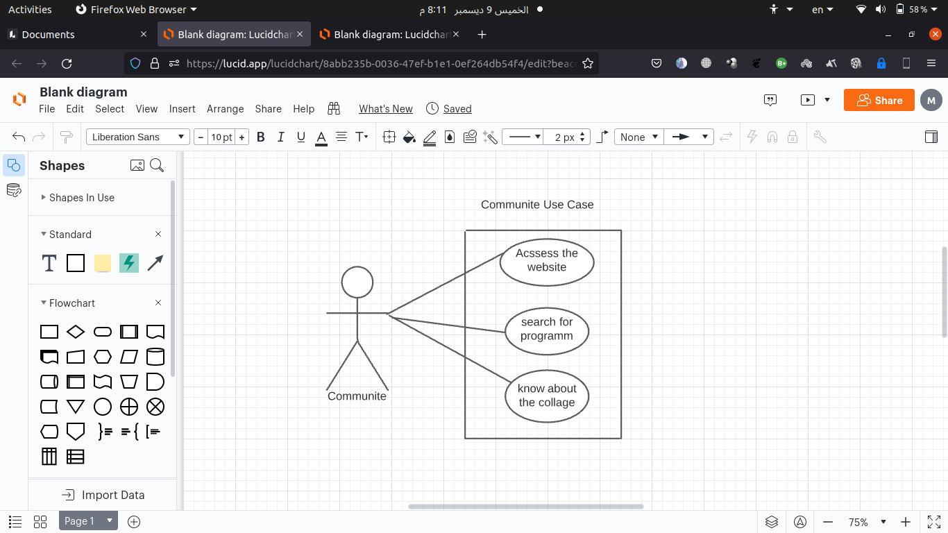
Use Case Diagram for Communite of the Collage Website

Slide 13
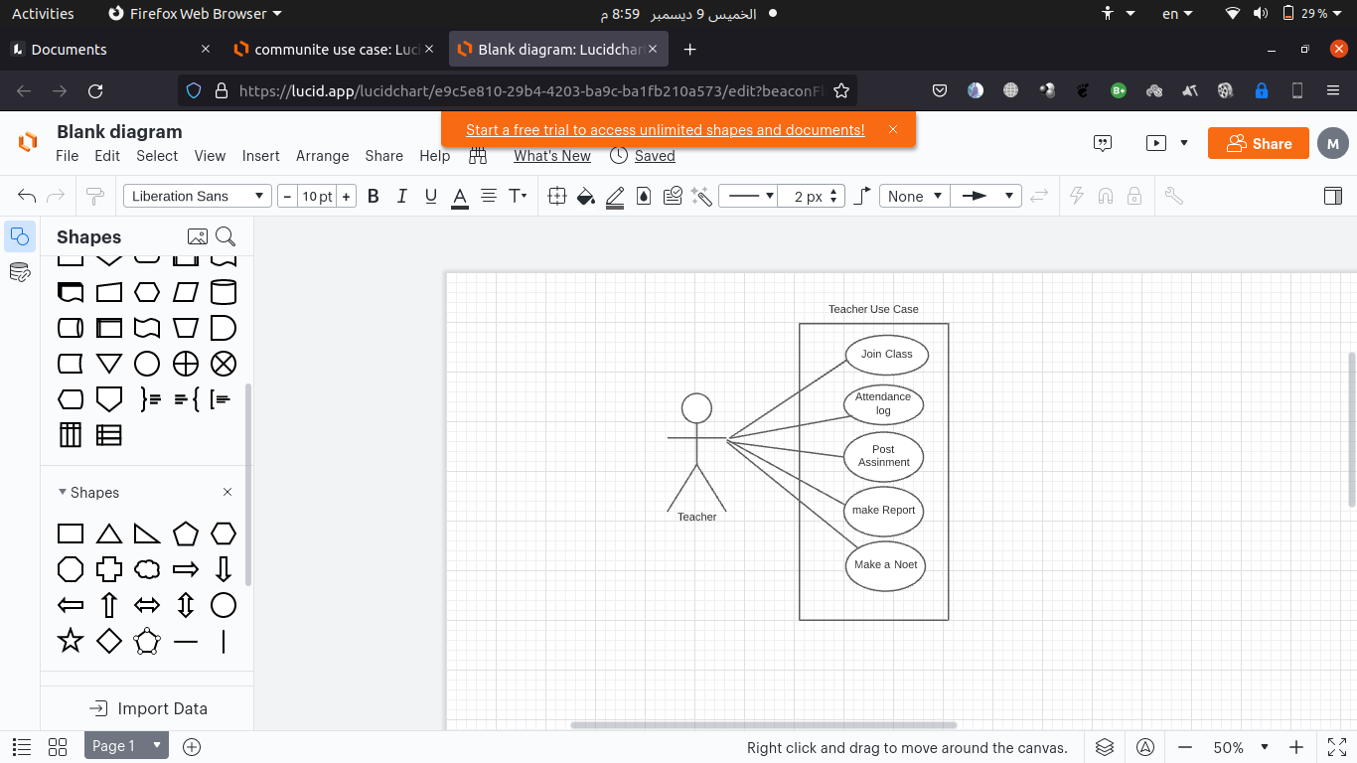
Use Case Diagram for Teacher of the Collage Website

Slide 14
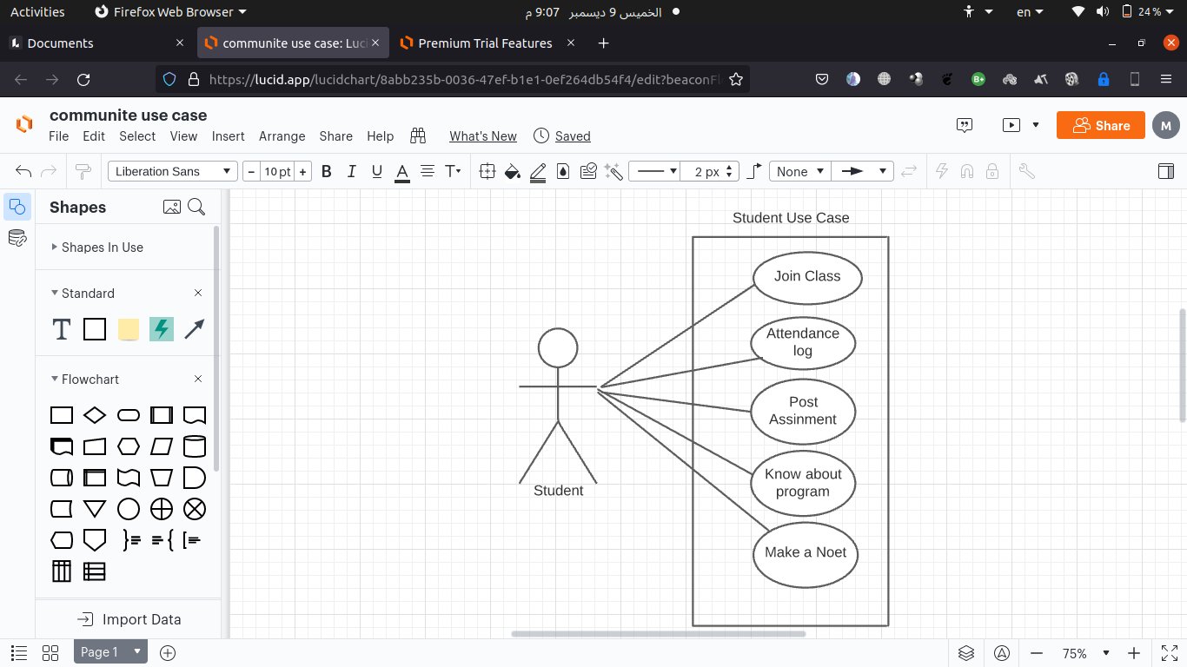
Use Case Diagram for Student of the Collage Website

Slide 15
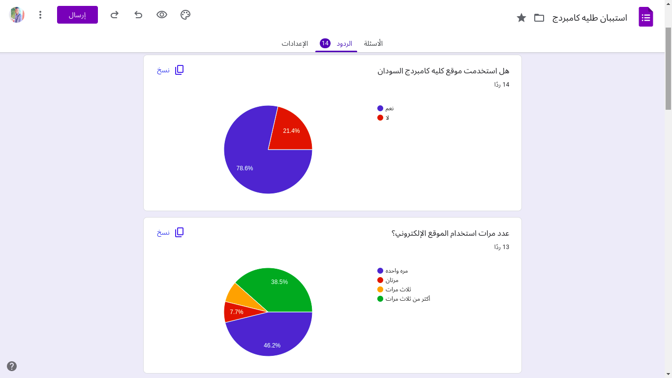
questionnaire

Slide 16
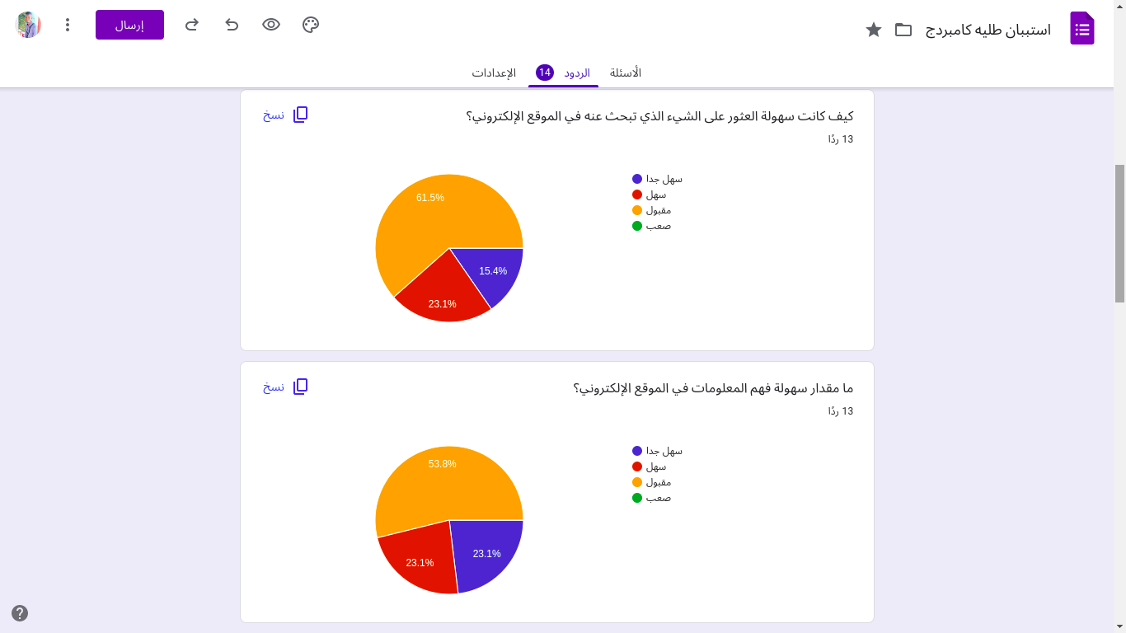

Slide 17
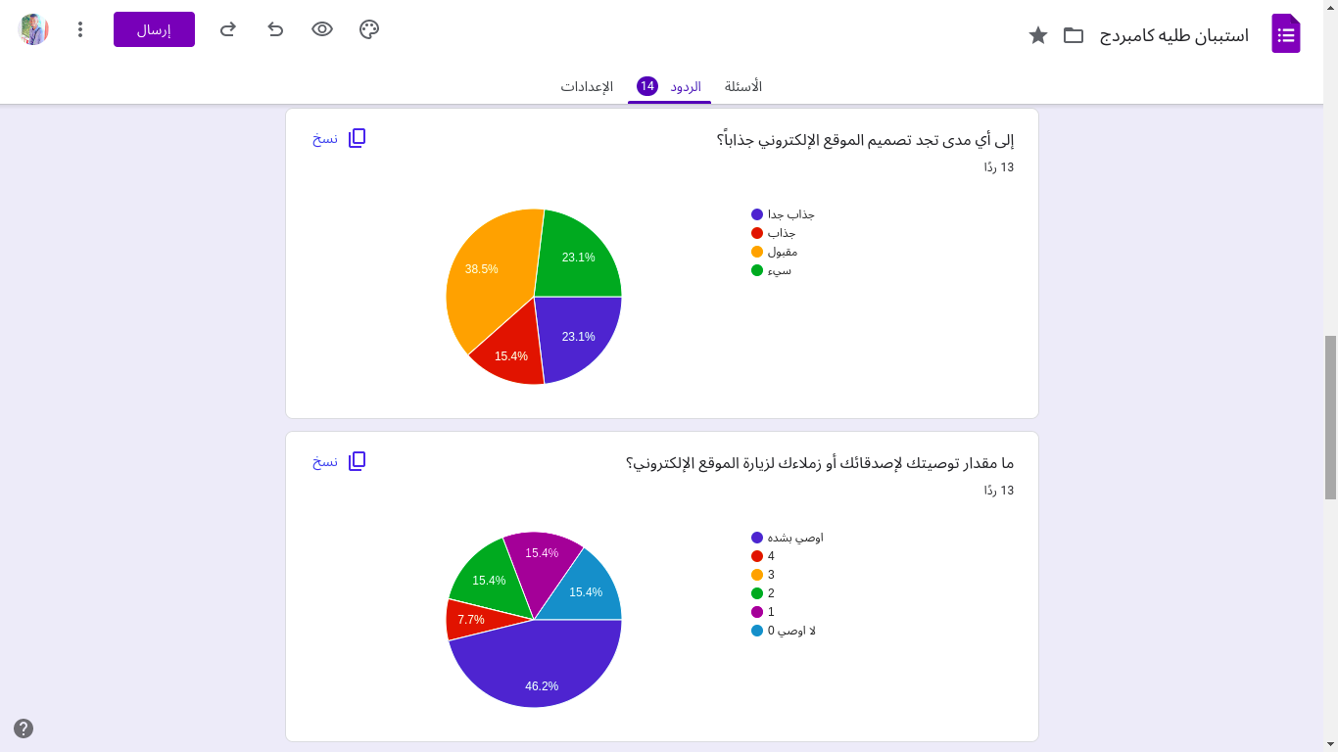

Slide 18
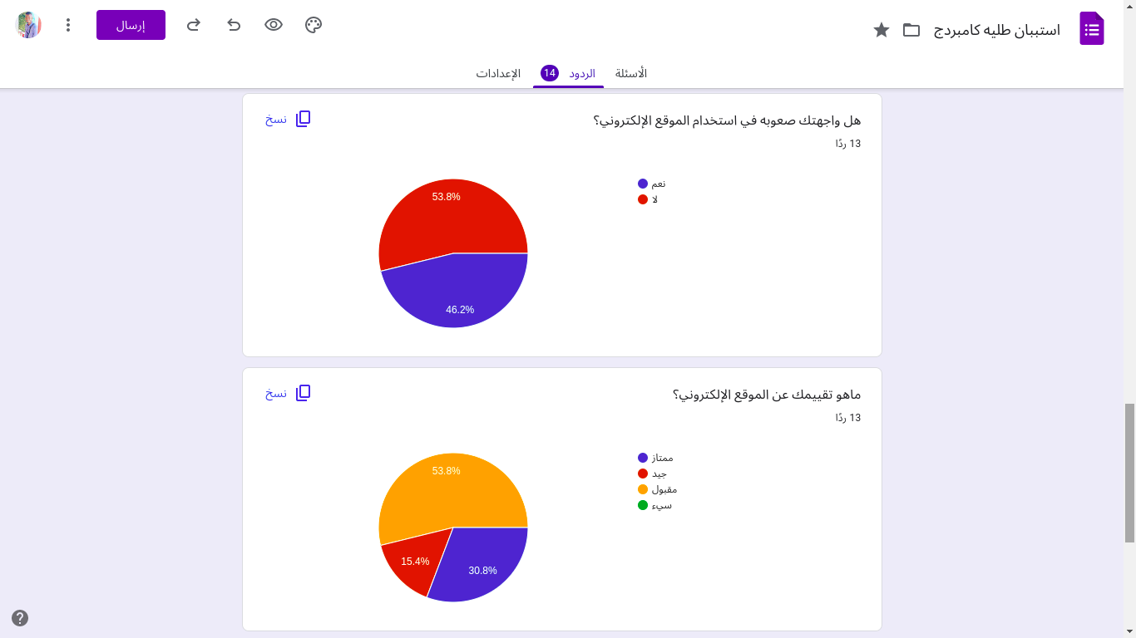

Slide 19
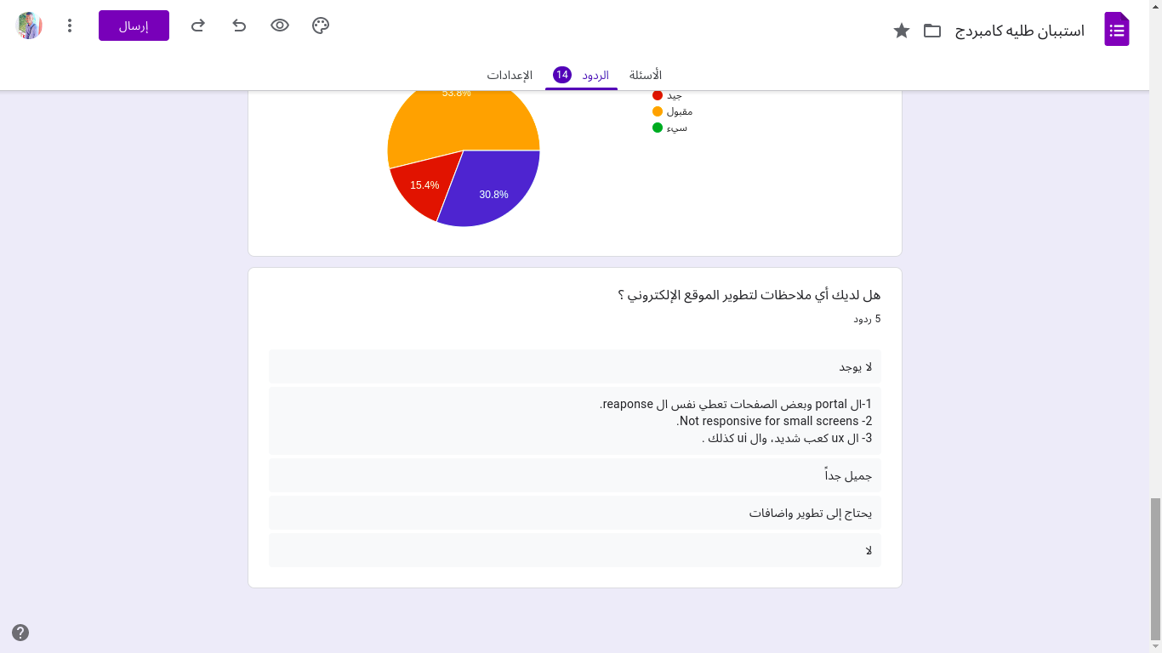

Slide 20
Chapter four Design & implementation
Enable to whole Computer screen :
the website use full screen of view , the old one non-responsive to full computer screen .
Mobile & Tablet features :
be flexable of use mobile and tablet featuers .

Slide 21
Refuse Duplicated non workable links :
Avoid duplicate and non workable links , old one
+++++++++++++++++++++++++++++++++++++++++++++++++++++++++++++++++++++++++++++++++

Slide 22
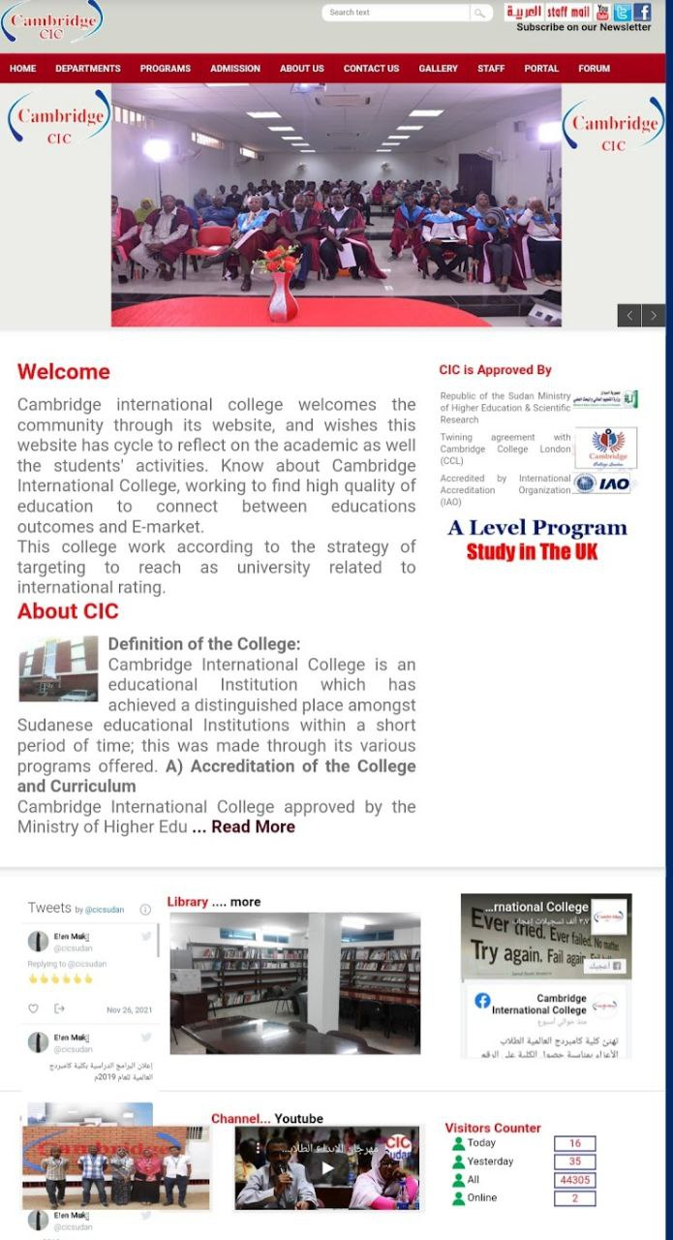
old Home screen:

Slide 23

Home Screen

Slide 24
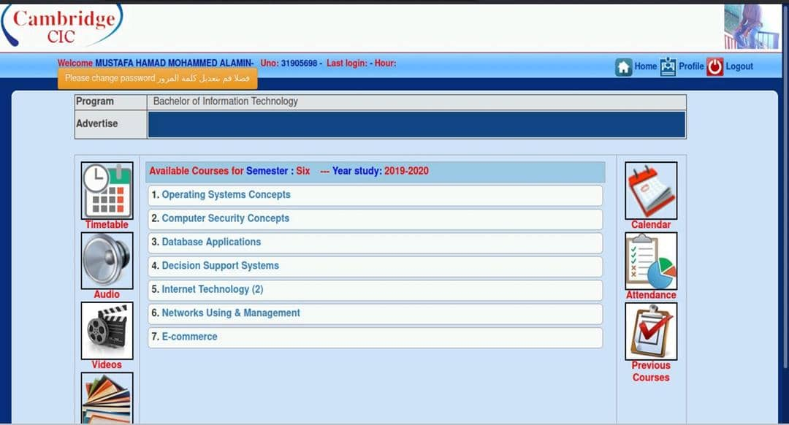
student Screen

Slide 25
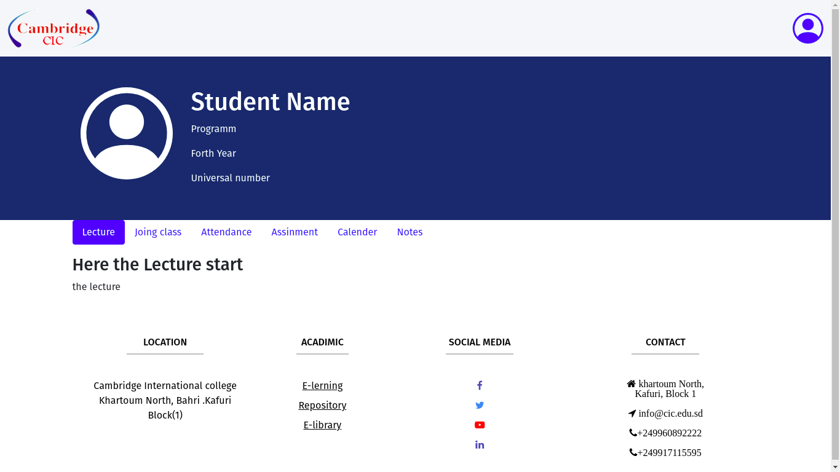
Student screen

Slide 27
Chapter 5: Recommendation and conclusion.
5.1 Introduction:
The aim of this chapter is to draw conclusions of the work
done or achieved and to give an assessment of the
completed Design, discuss the Problems faced and give
future recommendations on how the design can be
improved.
5.2 Results:
The possibility of communicating with teachers or students ,Provide time for teachers to follow up on students and do their assignments, Increasing the effectiveness of teachers, Changing programs and curricula very quickly on the Internet, in accordance with the requirements of the times or the plans pursued by the Ministry, without any high costs.
Overcoming the obstacles that prevent the access of scientific materials to students, whether they are in remoted places or outside the borders of countries

Slide 30
References:
UML
Unified Modeling Language
/https://lucid.app/
mashreq university website
http://mashreq.edu.sd/index.php
/https/arxix.org/International Journal of Soft Computing and Software Engineering [JSCSE], Vol. 3, No. 3, pp. 786-794, 2013
technolgy in socity

